Slide 1
Using Creative and Visual Methods in Comparative Research

Slide 2
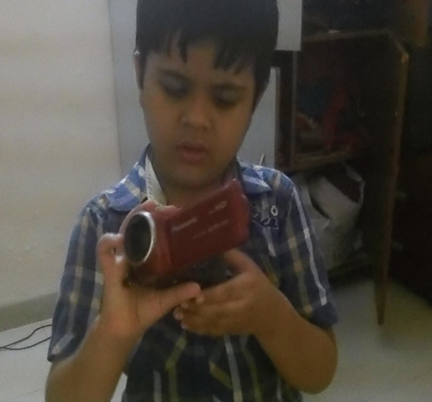
Using Visual Technologies
in Comparative Studies:
Researching Young
Children's Perspectives on
Fathers
Dr Rita Chawla-Duggan
Department of Education, University of Bath
Friday 15th June 2018,
University of Surrey

Slide 3
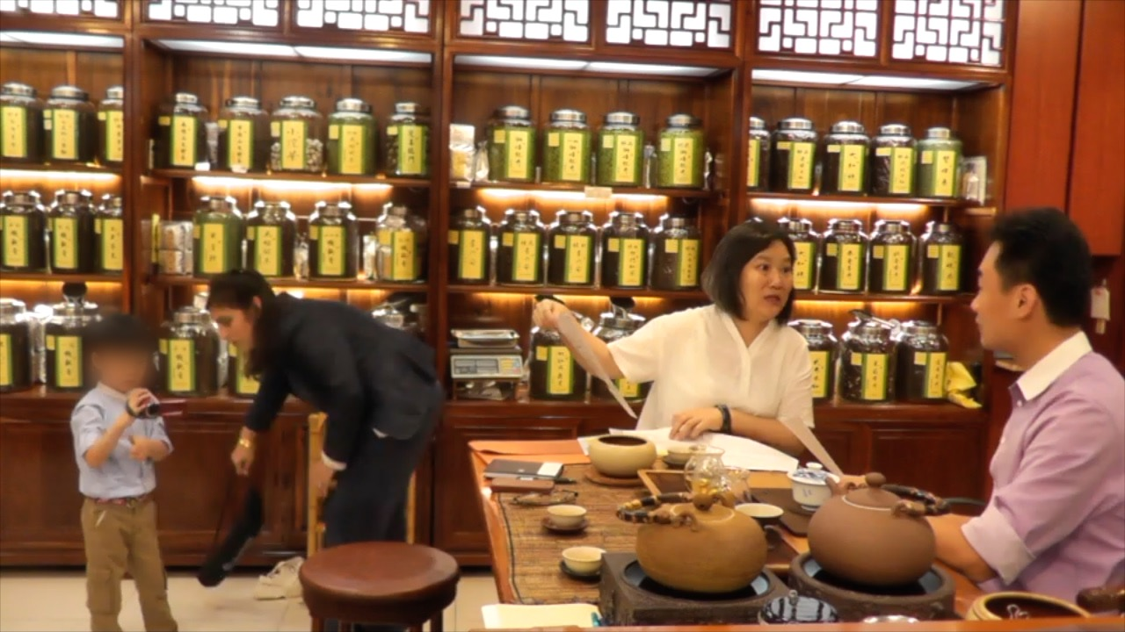
Training and project introduction

Slide 4
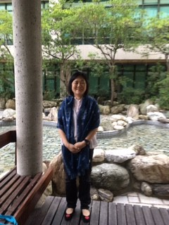


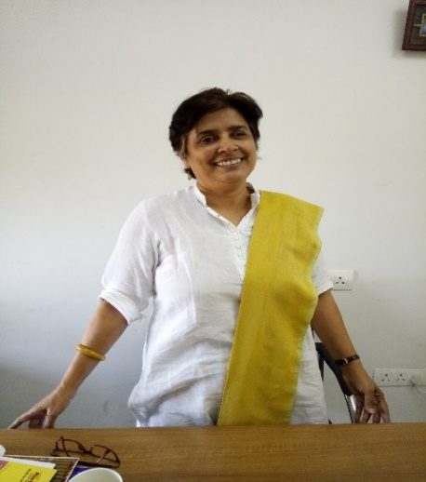
Using Digital Visual Methods in Cross Cultural Research with Young Children (Funder: BA/Leverhulme)
How can we use visual technology critically, to explicate learning as developing through interaction between young children and fathers in home environments, from the child’s perspective, across four national contexts?
Dr Michelle Lam - Education University
of Hong Kong
Dr Sissell Sollied -
- University of Tromso (UiT), Norway
Dr Rita Chawla-Duggan
– University of Bath, UK
Dr Rajani Konantambigi
-Tata Institute of Social Sciences (TISS), Mumbai, India

Slide 5
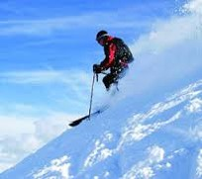
Direction
Potential of visual technology in cross-cultural
case study:
research with young children
practically useful for intervention work
scope – with international teams
Possibilities realised by building reflexivity into cross –cultural research design :
implications for the quality and scope of knowledge
produced

Slide 6
Plan
Introduction
Research design – problem, theory and method
Issues, problems of using visual technology in cross cultural case study research
Data collection – engaging young children and collecting reliable footage
Visual analysis with young children and comparisons to ensure validity
Points of comparison
Conclusion: closing scenes for scope and possibilities using visual technology

Slide 7
RESEARCH DESIGN
– PROBLEM, THEORY AND METHOD

Slide 8
Why visual technology for our problem?
Young children : Influence of HLE (Sylva et al 2004; Feinstein 2003);
Fathers and children’s outcomes (Flouri and Buchanan 2004);
Paternal engagement not easily handled methodologically – correlation; adult perspective
Visual methods : potential for collaborative research (Clarke and Moss 2011; Pink 2013)
A lack of criticality to visual methods in education (Buckingham 2009)

Slide 9
Aim/objectives
Research design
Using visual technology critically to explicate how fathers engage in child development within home environments, from the child’s perspective, across four national contexts
1. Explore young children’s visual representations of paternal engagement
2. Document the process of producing young children’s visual representations
3. Explain cultural differences in young children’s representations (where the culture is the HLE;
4. Develop a cross cultural methodology for representing young children’s relationships in home environments across national contexts

Slide 10
Visual technology as a source of data
Possibilities
  photographs
  web based sources
  tablets
  digital camera recorders
  video productions
  mobile phones
How can we understand their potential?

Slide 11
Epistemological and theoretical positions
Children’s learning and development - What theoretical perspective about child development have we been using and why use visual technology?
Visual representations and knowledge – what assumptions do we make about knowledge produced through using visual technology?
Cross cultural case study – what are the points of comparison? when we use visual technology?

Slide 12
Our model of development
…….development is a continuous process of self-propulsion characterised primarily by a continuous appearance and formation of the new which did not exist at previous stages. This point of view captures in development something essential to a dialectical understanding of the process (Vygotsky, 1998, p.190)
….here development is not already formed and consequently requires methodological tools that enable researchers to document and analyse children’s intention and engagement across activity settings as part of the process of ‘propulsion’ in a dialectic situation
(see Fleer and Ridgeway 2014)

Slide 13
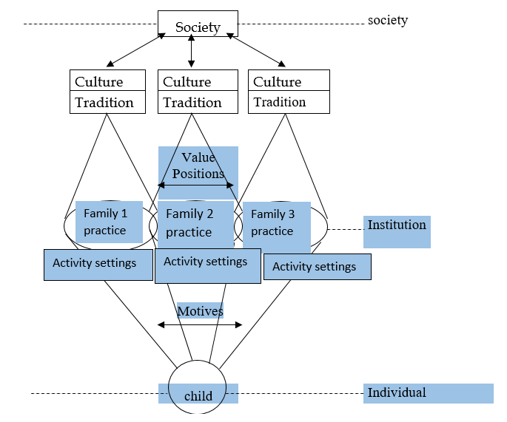
A Model of Children's’ Learning and Development – adapted from Hedegaard and Fleer 2008:10
Children’s learning and development
Theoretical positions

Slide 14
Key concepts
Activity settings
An activity setting can be compared to a scene in a theatre where both the materiality and the way of interaction reflect tradition in an institutional practice’ (Hedegaard 2012 : 131).
The social situation of the child
The child’s social situation of development is a key concept that conceptualises the environment of which a child is a part, and this includes both its social and material conditions alongside the child’s ‘predicament’ (Blunden, 2008)

Slide 15
Visual representations– assumptions about knowledge
A reflexive position – visual representations
What kind of knowledge is produced through using visual technology?
Scientific realist
Reflexive
Objectivity
Purpose – support written
Potential of visual often not explicitly shown
Subjectivity
Purpose – often how to prove it against the written; another kind of knowing

Slide 16
On being reflexive…
A reflexive approach to using visual technology:
  We need to go beyond the possible source of data to include the ways in which the researcher works with the source and the data it might yield (Pole 2004)
A reflexive approach that focuses on the question of how knowledge is produced through the relationship between the researcher, the subject of the ethnographic video and the technologies used (Pink 2007 : 16)

Slide 17
Cross-cultural case study : Issues to consider
Defining the boundaries of the case
and the unit of analysis for comparing.
Selections for comparisons and their basis
Defining the temporal
In multiple cases defining what and how is being compared.
Multi-site cases – what is being compared/ problems affecting comparisons?
Mutual construction of understanding in different language contexts.
(adapted form Burgess 2001; Broadfoot 2001)

Slide 18
Research Design
Case - learning as developing through interaction between father and child in home environments
Multi case/multi site (3 x4)12 families across four country contexts –Norway, Hong Kong, England and India
Sampling - theoretical
  within case – middle class fathers (housing, employment and education: autonomy; variation within middle classes); two parent, heterogeneous couples; age related sibling structures (3-8 years old/ pre-schooler, and one who had started school or within the last two years); adult –child relationships
  Within site – four countries (differences in societal values/beliefs/policies informing institutional interaction)

Slide 19
Data collection
Research Design
Data sets:
Participant/child generated digital film footage of regular interactions (activity settings/child’s social situation) (x2) using digital technologies (action camera -Go Pro/ digital video handi cam/ pocket video cameras)
Telephone interviews with fathers – feedback on evolving technical methodological issues
Film elicitation interviews with children/fathers (2 per family)
Researcher generated digital film recordings (2/family) to reflexively examine how children engage with the subject of footage
Face to face interviews with fathers focus on fathers values –
- to pull out and compare how father’s values are informed by wider societal conditions and inform the psychological work at home.
(1 & 4 used to compare internally - father child interaction and learning opportunities critically)

Slide 20
ISSUES AND PROBLEMS OF USING VISUAL TECHNOLOGY IN CROSS CULTURAL CASE STUDY

Slide 21
Within case
Visual analysis with young children and comparisons to ensure validity
Activity settings and the child’s perspective in relation to social situation (conditions for development): a prerequisite for examining different kinds of instructional relationship

Slide 22
Comparing conditions for development for different activity settings
What activity settings between father and child dominate the institutional practices of each family?
What does the father expect from his child in these practices?
How does the child act in the activity settings between father and child?
What kinds of conflicts occur between different demands of father and child? (Adapted from Hedegaard, 2008, p.17)

Slide 23
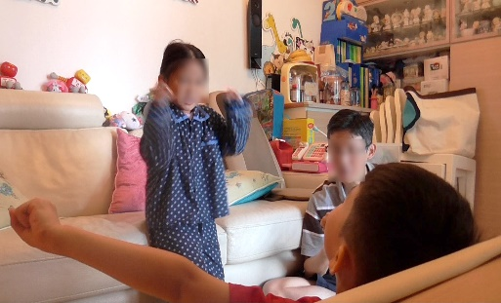
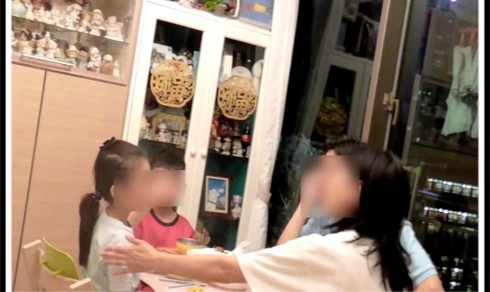
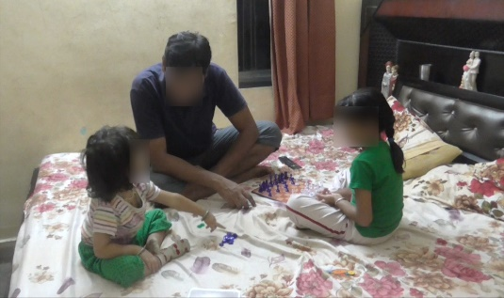
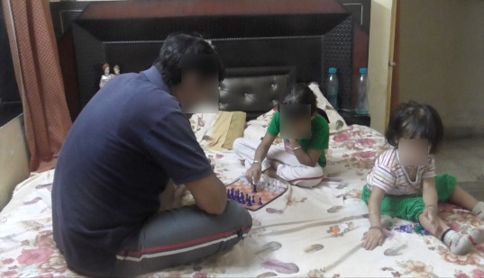
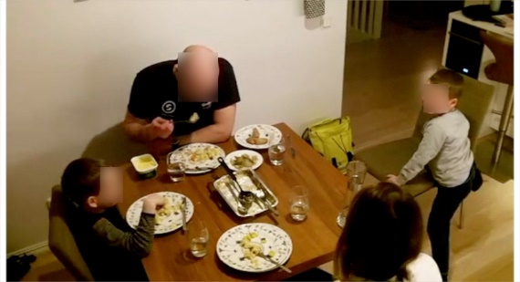
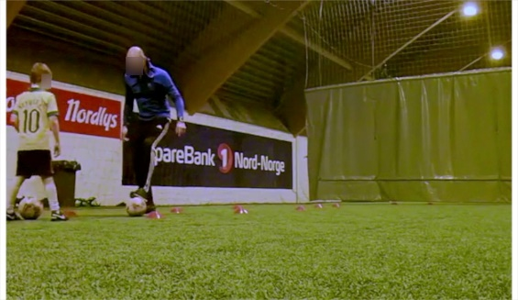
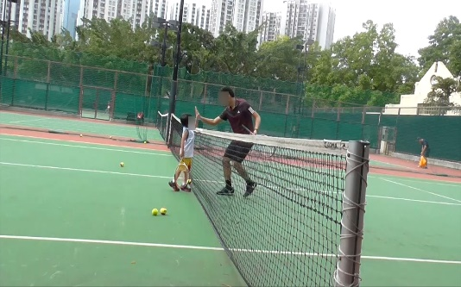
Participant-child generated footage - activity settings
Examples of activity settings
Eating together
Playing games

Slide 24
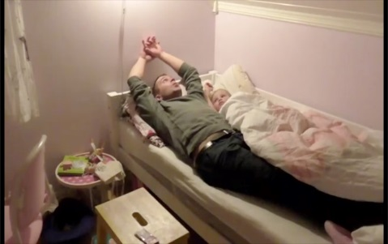
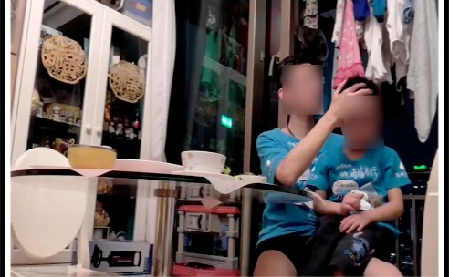
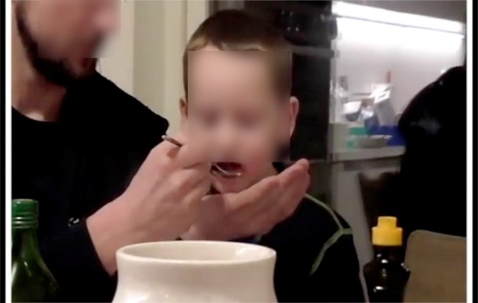
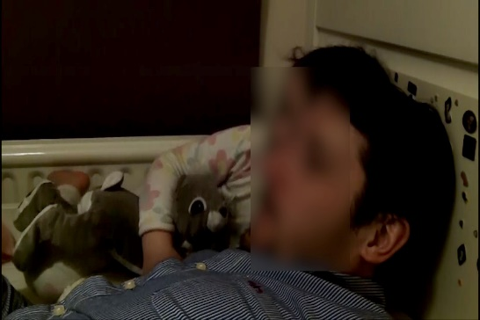
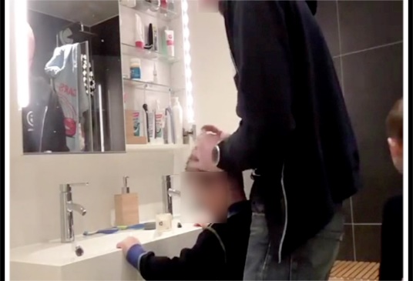
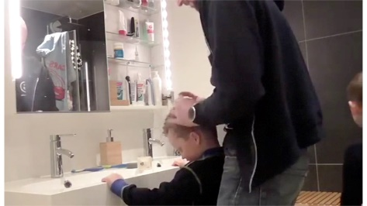
Participant generated footage - activity settings
Examples of activity settings
Bedtime stories
Being cared for

Slide 25
England: institutional level
Regulatory context
 | Family 2 | Family 3 | Family 4
 | Mealtimes- eating and talking together with family | Mealtimes- eating and talking together with family | Mealtimes- eating and talking together with family
Strong regulatory context | Doing homework at mealtimes (esp breakfast) | Doing homework at mealtimes (esp breakfast) | Doing homework at mealtimes (eg Saturday lunch or supper)
 | Doing homework
 | Going to school | Going to school | Being together as 1:1 relationship - Relationships with dad
 | Preparing for bed :personal hygiene | Preparing for bed :personal hygiene; bedtime stories | Preparing for bed: bedtime stories
 |  |  | Doing Technology with dad
Weak regulatory context | Having lunch with little one | Being together at mealtimes
 | Playing games/technology with dad | Discussing ideas (using technology) | Doing Technology with dad
 |  | Being together as 1: 1 relationship
 | Walking the dog | Working on a school project - family
 | Cooking together | Playing games as a family | Playing with dad
 | Preparing for bed : bedtime stories) | Watching tv as a family
 |  | Preparing for bed – personal hygiene/bedtime stories

Slide 26
Accessing the child’s perspective (object oriented motive) – through the child’s social situation
The easiest way to understand a child’s intention is to note when there is a conflict where the child cannot do what he or she wants to do and cannot realise the projects in which he or she is engaged. As such a cultural-historical methodology needs to focus on the conflicts between the child’s intentions and what he or she is unable to realise…., conflict should be seen as a way to understand the child’s motive and to see what he or she is oriented towards. Conflicts also allow the researcher to note the ways in which a child interacts with his or her surrounding and this given greater insight into the child’s perspective. (Hedegaard 2008 : 19)

Slide 27
Comparing internally to ensure validity
Participant generated footage | Researcher generated footage
Footage of activity settings sampled for conflict, emotionally charged behaviour and scaffolding What is the social situation of the child with opportunities for development in the activity setting? (i.e. the social/material conditions the context creates, including how the child acts and how the father responds) | Footage of children watching themselves in activity settings with father When the child/children watch the footage of their representations how do they respond (spoken and body movements) to the subject of the images? How does their response influence our understanding of their social situation of development? What factors are informing the researcher's understanding of the social situation of the child?

Slide 28
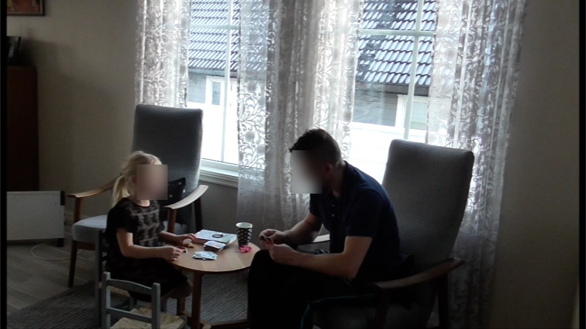
F1 Norway: Participant generated footage - Conflicts/emotional charged footage – data for the child’s social situation :playing cards being fair

Slide 29
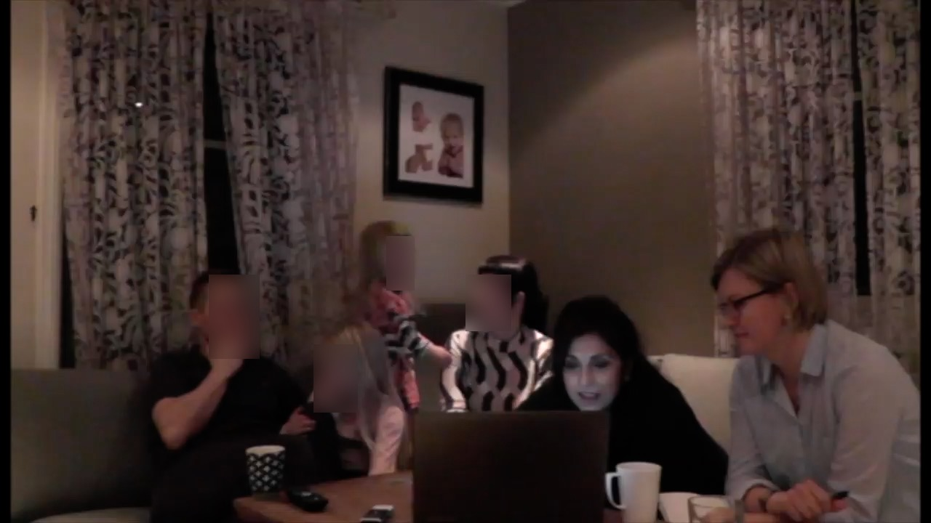
Playing cards - Being fair/changing rules : how does she respond to watching the conflict?

Slide 30
Comparing participant and researcher generated footage
When the eldest sister watches the conflict - her non verbal response shows a strong interest (and sustaining interest is a problem) ; and her lack of verbal response elicits a broader range of perspectives to help us understand the child’s social situation
The child’s motive : change the rules to win & negotiate with father; father – being fair is what matters; a regulatory discourse (object is about negotiating moral conduct )
Compare what other activity settings have this motive for this child-father relationship in this family?
What are the development possibilities from this?

Slide 31
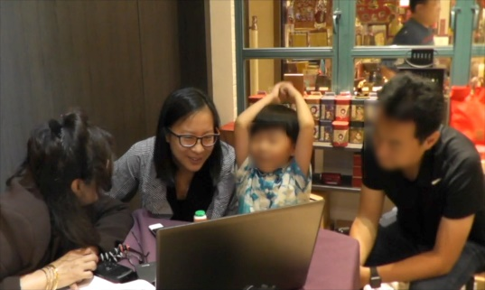

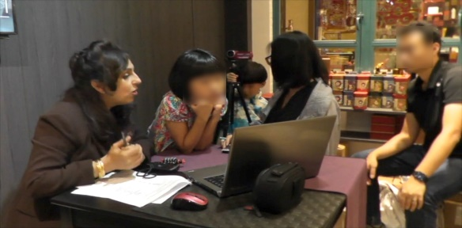
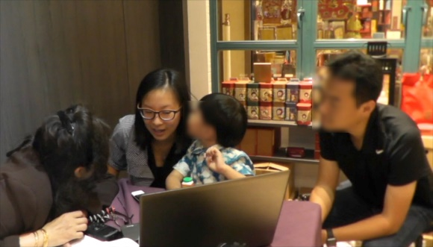
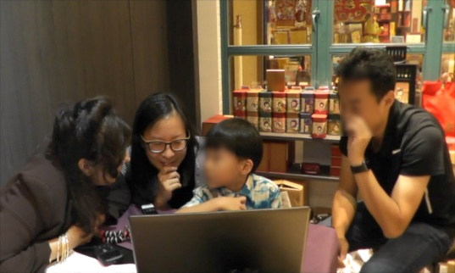
Hong Kong Family 1: Activity setting - playing games
Problems in comparing - young children’s attention
The children : Anna (7) ; Alex (5)
How does Alex respond to the
footage? – (footage field notes)

Slide 32
What is influencing the child’s attention ?
The older sibling – participation, recollection and expansion
Given that this would be the first time the young child would have this kind of experience; he may need time to recall his memory; that is, when the older sibling talks about the footage it may help the younger ones to think about what happened, or to understand the situation of being interviewed, or to talk about their experiences, as represented in the footage (International collaborator analysis: HK researcher).
The platform for the young child Alex to act in these ways - facilitated by his attention being drawn to watch his elder sibling participate in the dialogue.

Slide 33
What is influencing the child’s attention ?
The translator - emotional dialogue
Non attention to full attention. How?
researcher generated footage… a more intimate relationship develops between the researcher, the translator and the footage.
- an emotional dialogue is built; …attention becomes more sustained and qualitatively different, …demonstrated ….trying to express himself in two languages …use of gestures… how he hits the ball, …whispers in the translator’s ear… how he shuts his eyes, holding his arms up as if hitting the ball in the footage, because ‘he’s a bit afraid of the ball’. …

Slide 34
We might say…
First stimulus (film footage) - limited in generating and sustaining attention
Did the emotional (non-linguistic) response between the researcher or translator and the child function as a second stimulus?
So that the young child responded to the emotional dialogue and in turn generated and sustained attention.
Attunement as part of emotional dialogue is non-linguistic and we maintain, an important aspect of generating and sustaining attention (Broadfoot 2001 calls this constructing mutual understanding)
To what extent was I responsive to children’s non verbal signals

Slide 35
The value of the second stimulus…
Locating and understanding the second stimulus in visual analysis provides a critical position to researchers, upon which they make subsequent claims about comparing the opportunities for young children’s development in their relationships.

Slide 36
CONCLUSION:
CLOSING SCENES FOR SCOPE AND POSSIBILITIES USING VISUAL TECHNOLOGY

Slide 37
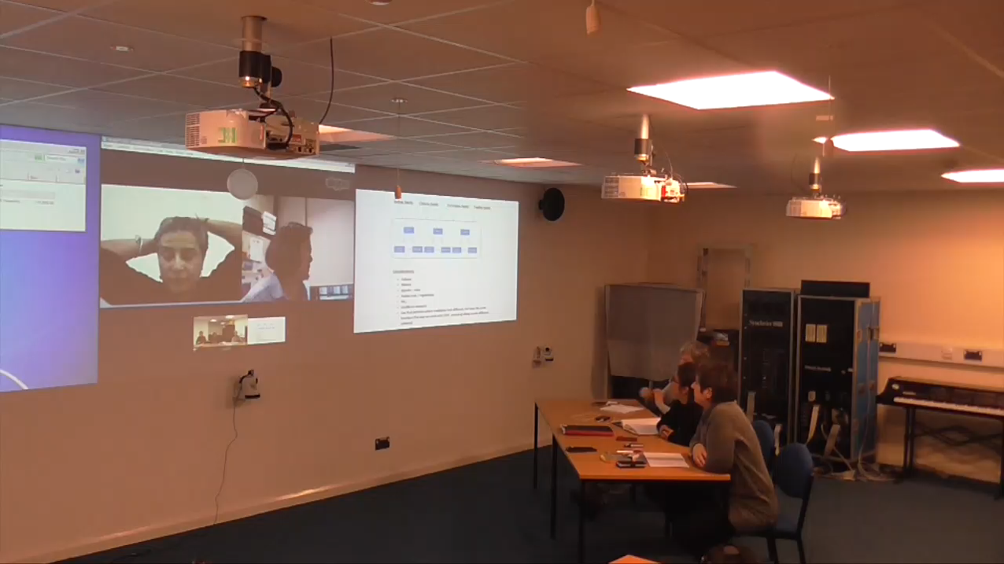
Comparing societal values and institutional interaction within country

Slide 38
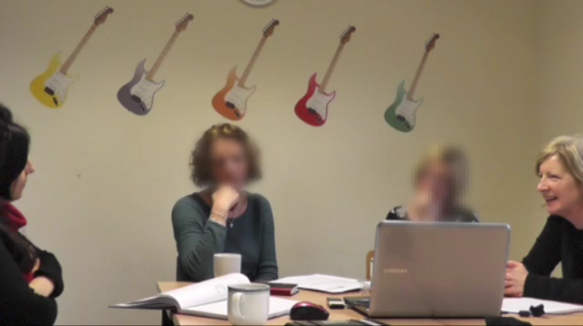
Scope – with teachers

Slide 39
Concluding comments
Visual technology is a reflexive device.
By implication it can be used collaboratively for comparison in a number of ways in cross cultural studies. This includes:
Working with young children : children’s reflexivity in visual analysis – to identify the problems of working with young children which affect comparisons and to ensure validity.
Intervention work –explicating practitioners values in how fathers support learning; their perspective of learning and development
International teams : team based reflexivity – collaboration and negotiation explicating how and what could be compared within the case and sites.

Slide 40
Family 1
Chawla-Duggan,R., Milner. S. and Porter. J. (2017) Reflexivity and Visual Technology in Research: Young Children’s Perspectives of Paternal Engagement in the Home Environment Qualitative Research
E.Mail: r.c.duggan@bath.ac.uk
Also available:
The Second Stimulus at work (submitted for publication)

